Slide 1

The Value of Beautiful
Big Mountain Resort
A data driven strategy for price determination

Slide 2
Problem Identification
Big Mountain wants to optimize their pricing by charging based on the value of their facilities rather than charging based on the market average
The resort is uncertain with regards to how important some of its facilities are compared to others
Can Big Mountain Resort raise ticket prices by a sufficient amount to increase revenue by $1,540,000 this season in order to offset operating costs by adding a run, increasing vertical drop by 150 feet and installing a new chair lift?

Slide 3
Recommendation and Key Findings
We recommend that Big Mountain should increase the price of a weekend ticket by between $4.48 and $25.26
We found that the number of runs, the amount of vertical drop, the amount of snow, and the number of fast runs are the features that correlate highest with ticket price

Slide 4
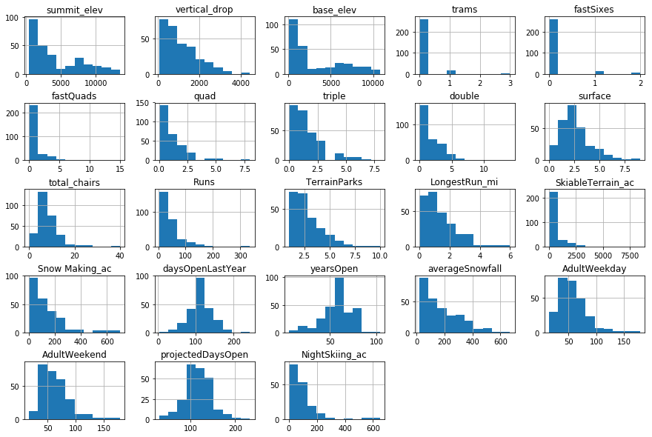
Modeling Results and Analysis
Distributions of features for Big Mountain Resort

Slide 5
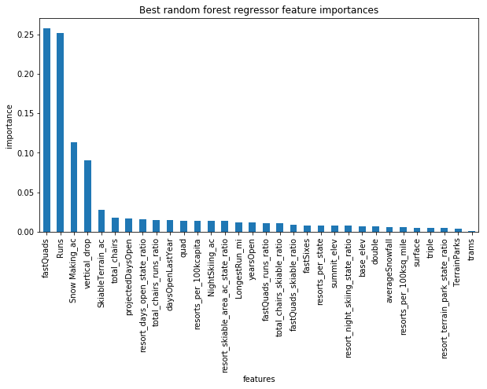
Modeling Results and Analysis
Features ranked by importance
Most important features are fastQuads, Runs, Snow Making_ac and vertical_drop

Slide 6
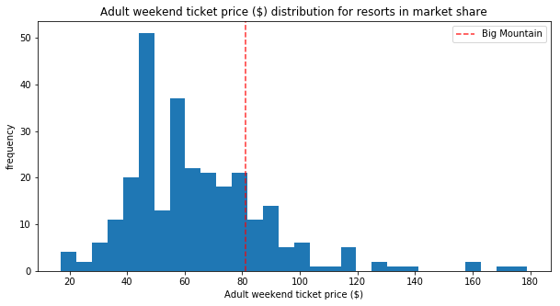
Modeling Results and Analysis
Distribution of weekend ticket price for US ski resorts
Note that Big Mountain charges a price that is close to the middle of the distribution

Slide 7
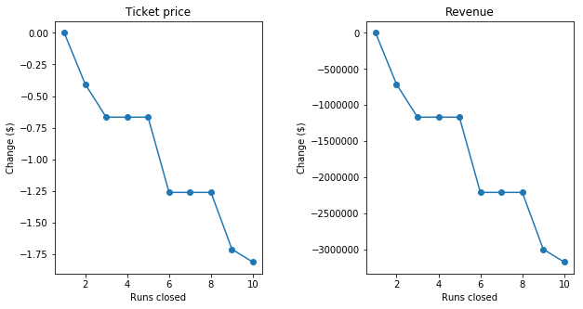
Modeling Results and Analysis
The graphed relationship between Runs Closed along with Ticket Price and Revenue, respectively

Slide 8
Summary and Conclusion
Big Mountain is a high value ticket because it has a large snow making area, a high number of chair lifts, a high amount of skiiable terrain and one of the longest runs out of any resort.
Because of this, we recommend that Big Mountain increase the price of a weekend ticket by between $4.48 and $25.26

